Slide 1
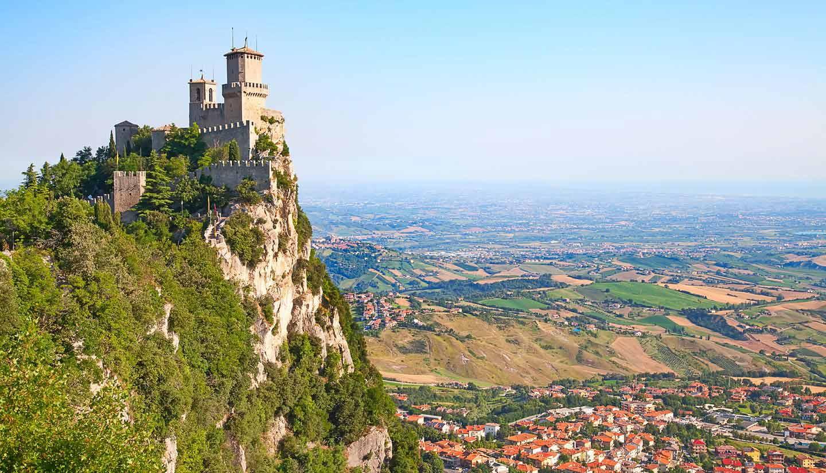
Najvznešenejšia republika san maríno
Lucia Kotuličová
Notes:
Iu&gkedaik

Slide 2
Vlajka

Slide 3
Hymna
https://www.youtube.com/watch?v=6_sTTG3HnDM&feature=youtu.be&fbclid=IwAR2Sgse4YR-fho-vweXLAOraPwij2ORb6ln6Q09MoZFBzBQmYrdCa8J72sg

Slide 4
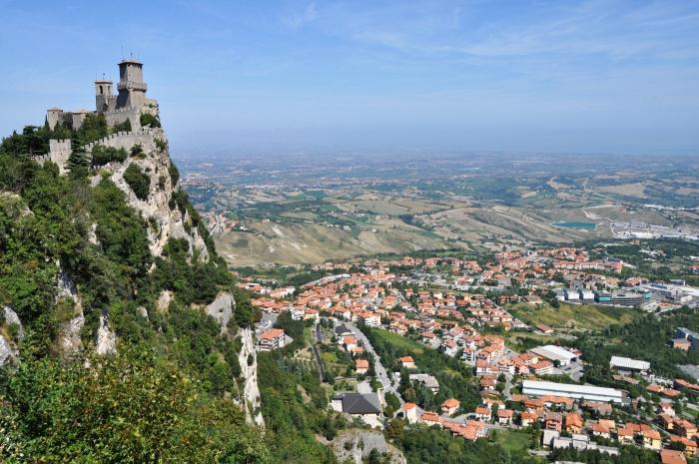
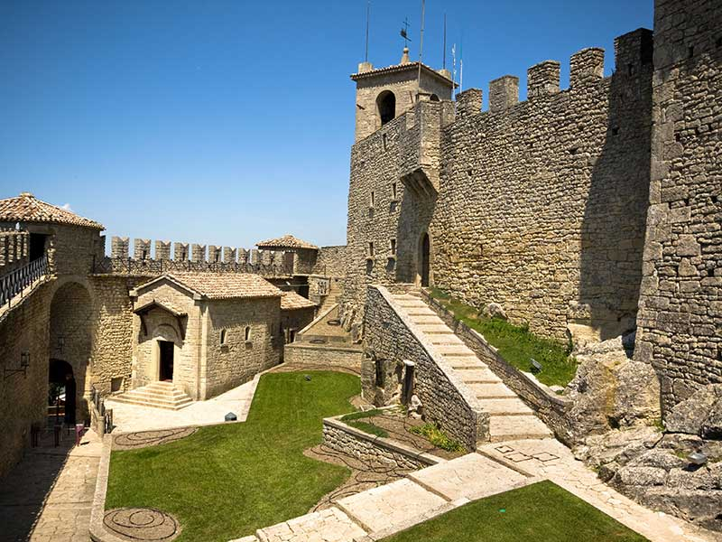
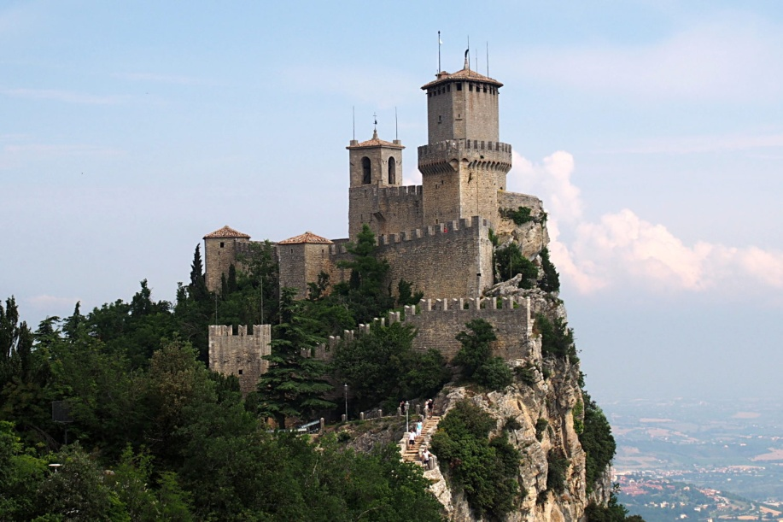
Tri veže na Monte titano

Slide 5
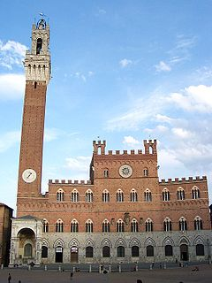
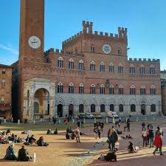
Palazzo Pubblico

Slide 6
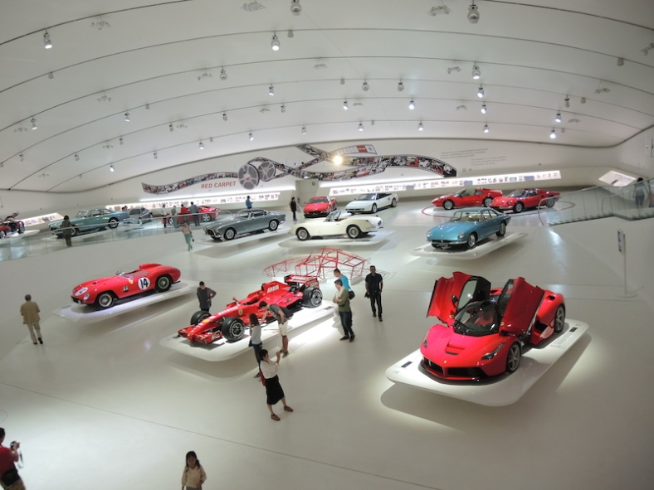
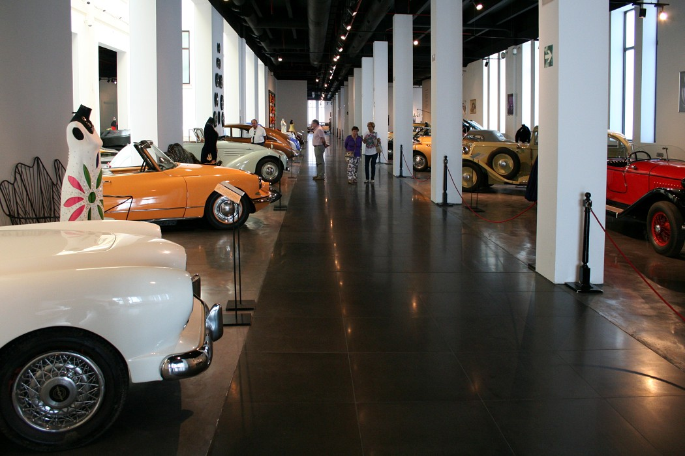
Múzeum starých áut (Museo Auto d'Epoca)

Slide 7
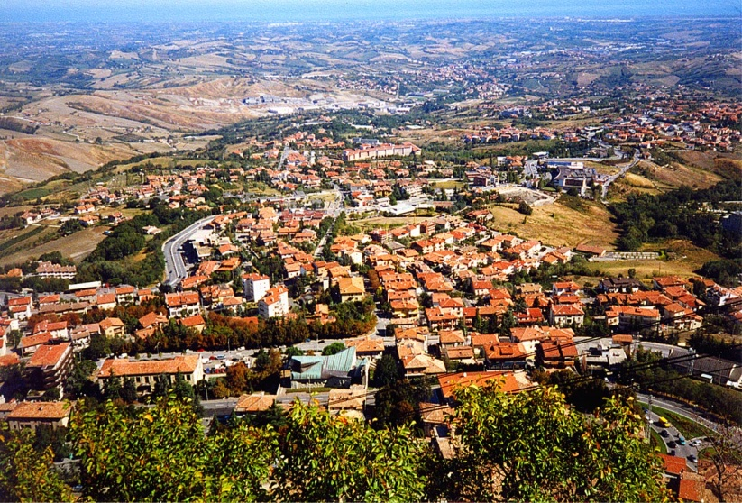
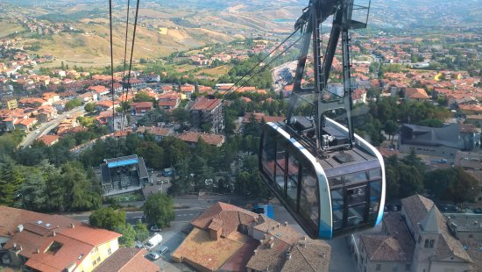
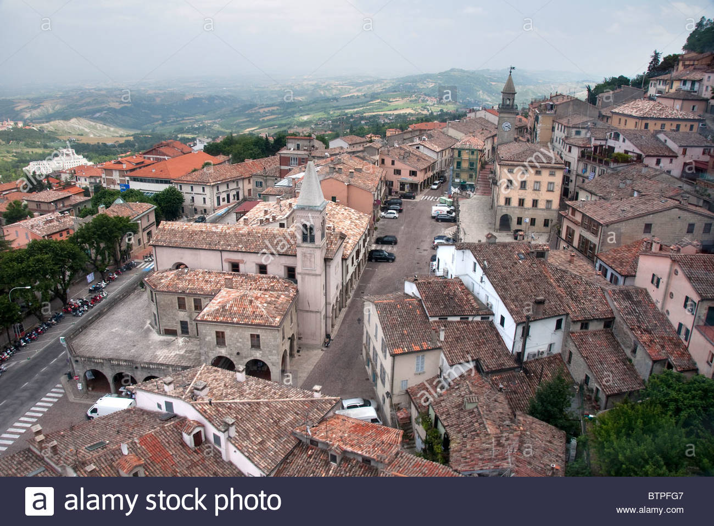
Borgo Maggiore

Slide 8
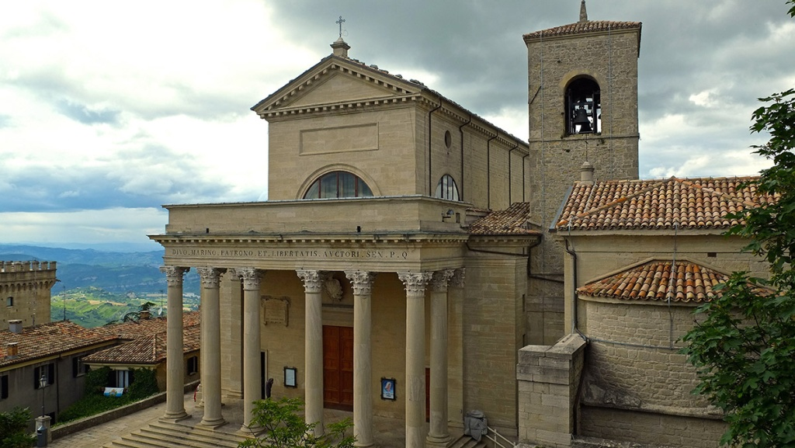
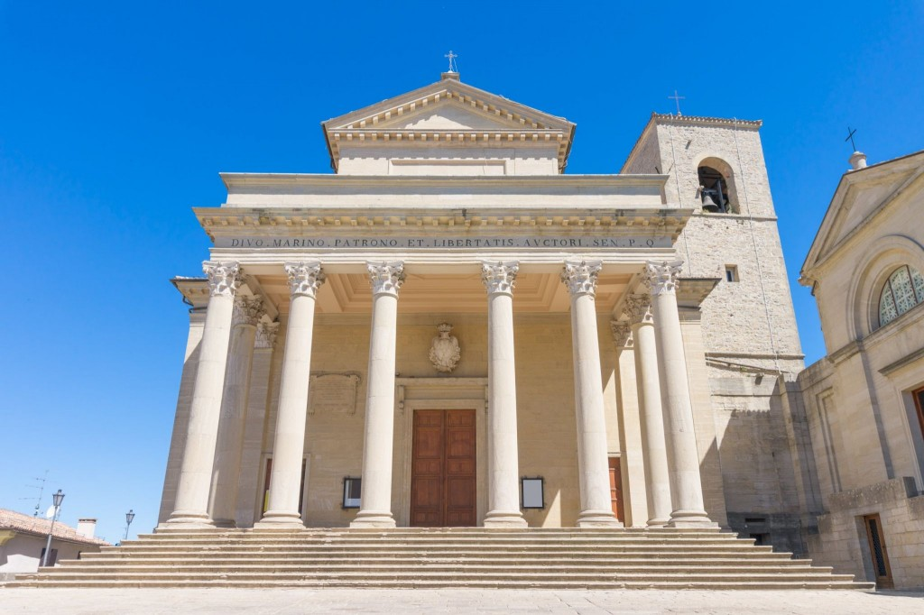
Bazilika San Marino (Basilica di San Marino)

Slide 9
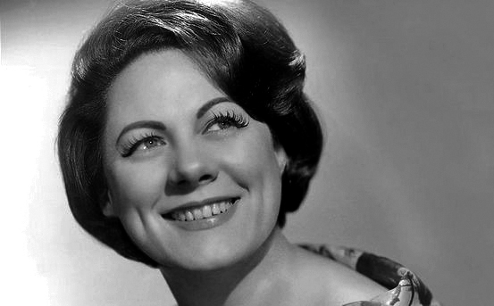
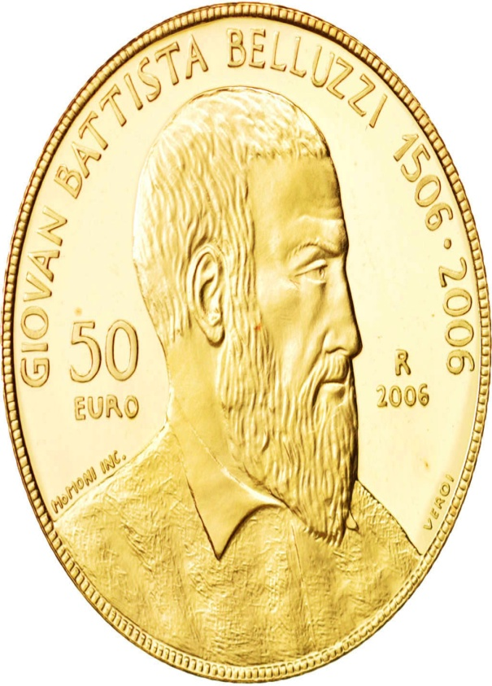
Osobnosti
Renata Tebaldi
Giovanni Battista Belluzzi

Slide 10
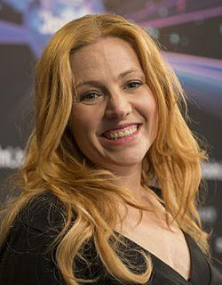
Hudba
Valentina Monetta

Slide 11
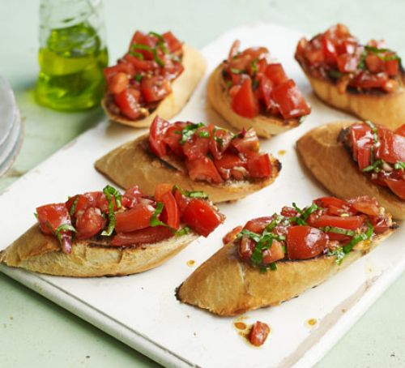
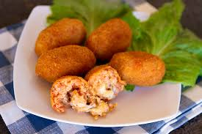
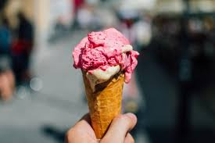
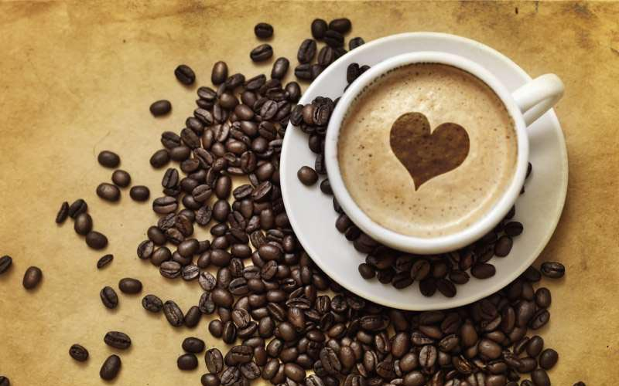
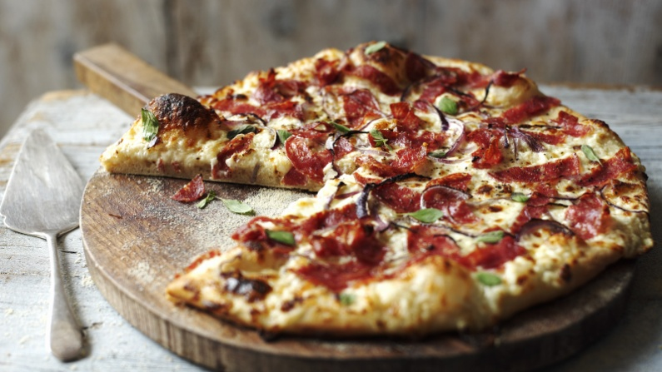
Kuchyňa
Suppli
Bruschetta

Slide 12
Zdroje
https://www.hedvabnastezka.cz/zeme/evropa/san-marino/22148-jidlo-a-piti/
https://www.travelmag.cz/zajimavosti-v-san-marinu-pamatky-a-zajimava-mista-k-navstiveni/
http://www.smartraveltoitaly.com/en/san-marino/
https://www.worldtravelguide.net/guides/europe/san-marino/food-and-drink/
https://www.google.sk/search?q=Giovanni+Battista+Belluzzi+san+marino&source=lnms&sa=X&ved=0ahUKEwjLjKr1q8zeAhWisqQKHRIVAEEQ_AUICSgA&biw=1232&bih=873&dpr=1.1

Slide 13
https://www.tripadvisor.sk/Attractions-g187808-Activities-c47-San_Marino.html
https://www.google.sk/search?q=san+marino&source=lnms&tbm=isch&sa=X&ved=0ahUKEwjmgaLagMzeAhXEyqQKHeNhAL8Q_AUIDigB&biw=1745&bih=881#imgrc=DjWvThJ-5xdVEM:
https://www.worldtravelguide.net/guides/europe/san-marino/food-and-drink/

Slide 14
Ďakujem za pozornosť

